Slide 1


DELITE KOM LIMITED
PREMIUM OFFICE FURNITURE RANGE

Slide 2
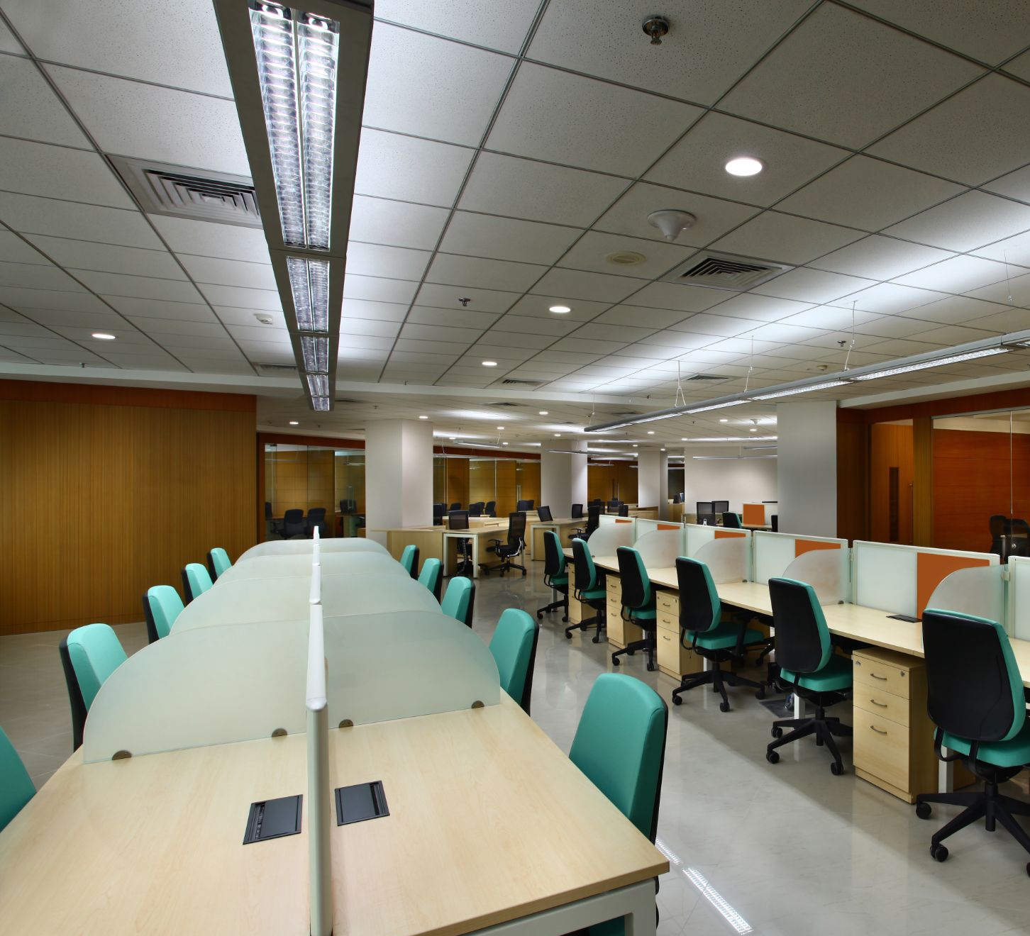
TABLE OF CONTENTS
01
TOP LEVEL MANAGEMENT FURNITURE
MIDDLE LEVEL MANAGEMENT FURNITURE
CONFERENCE TABLES
STORAGE OPTIONS
02
03
04

Slide 3
TOP LEVEL MANAGEMENT FURNITURE
Options for the Director’s Office

Slide 4
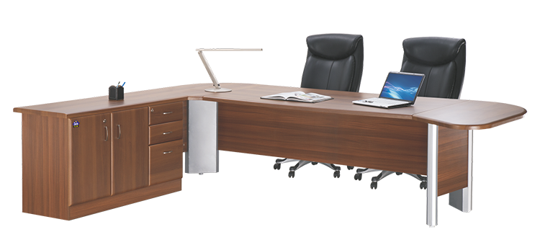
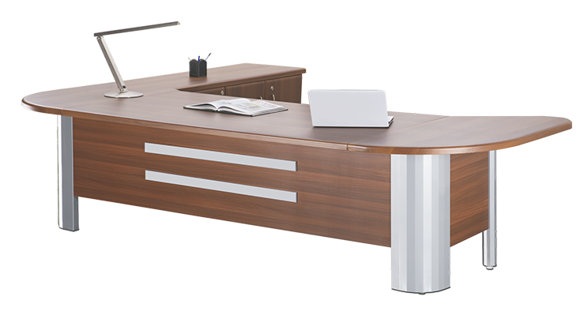
EUREKA SERIES

Slide 5
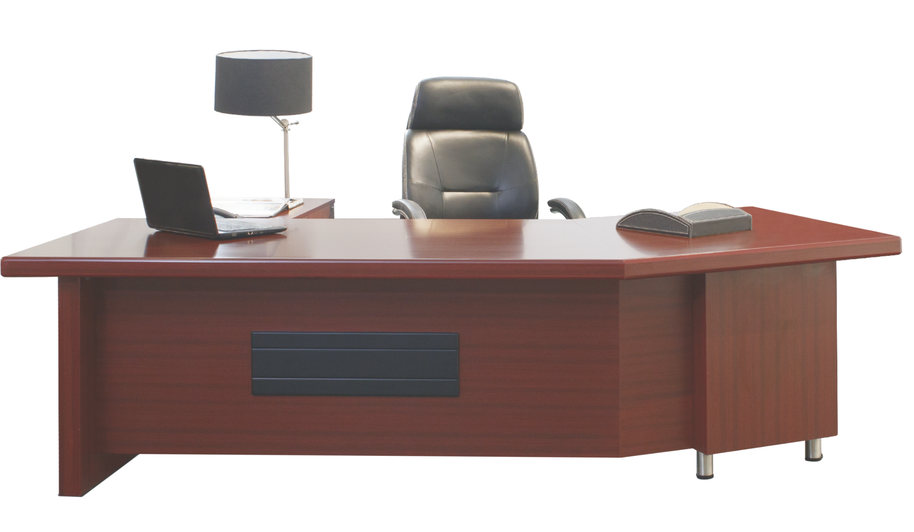
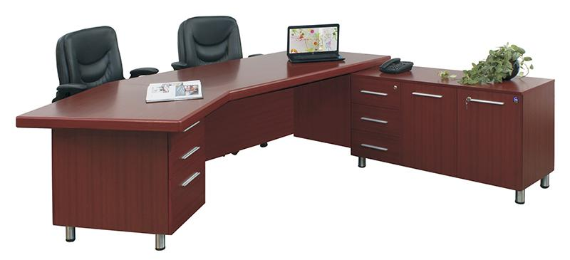
TRIUMPH SERIES

Slide 6
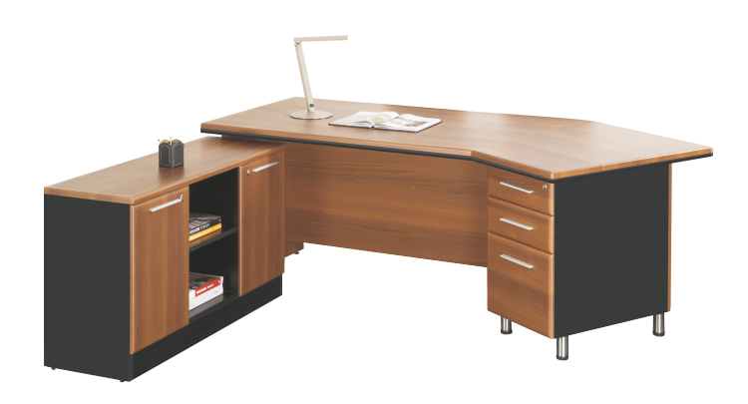
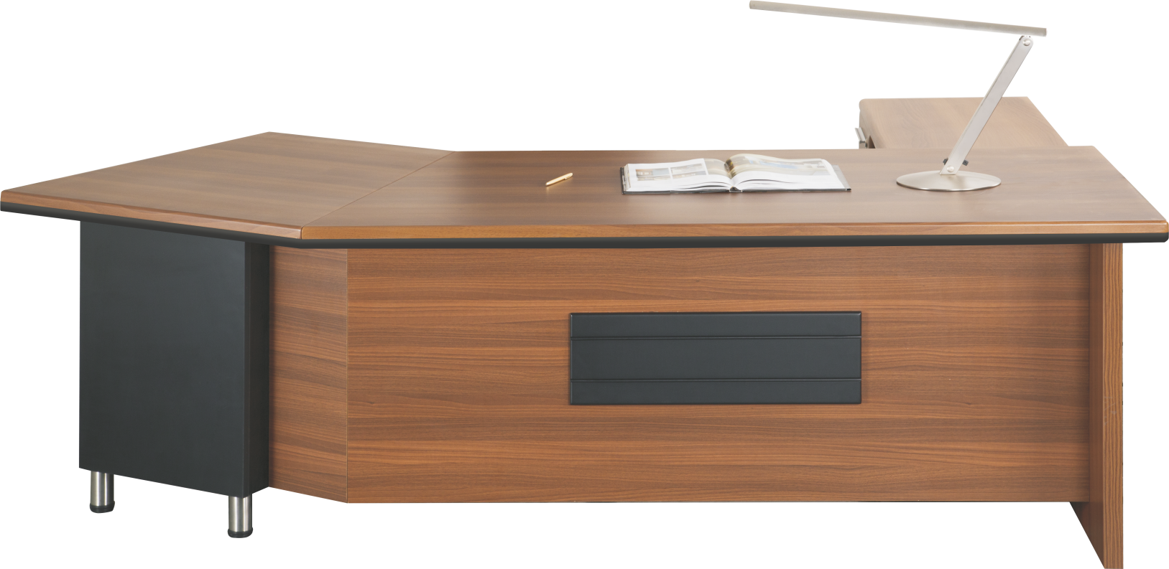
GLORIOUS SERIES

Slide 7
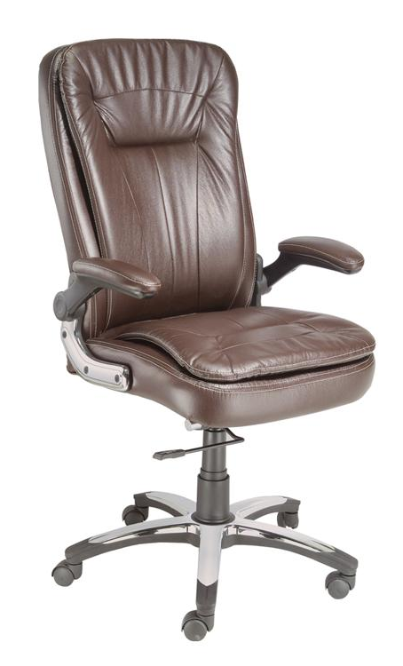
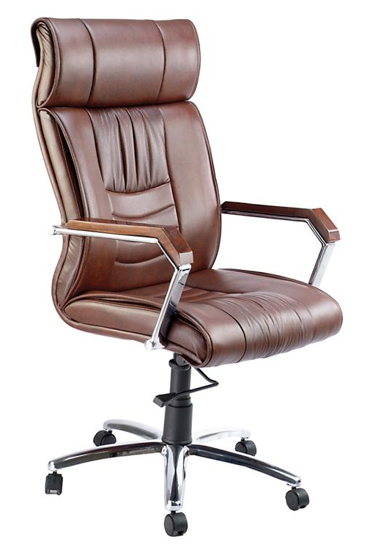
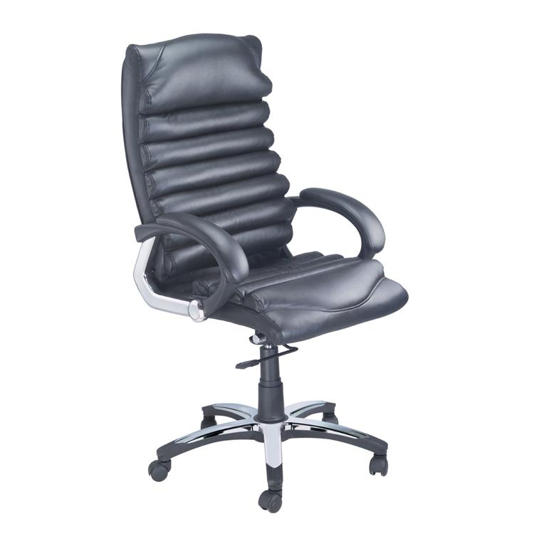
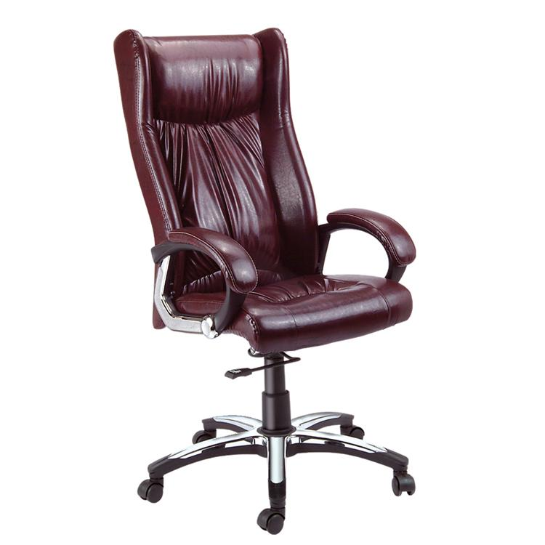
EXECUTIVE CHAIRS
Altis
Wing
Apex
Stream

Slide 8
MIDDLE LEVEL MANAGEMENT FURNITURE
Options for the Heads & Executives

Slide 9
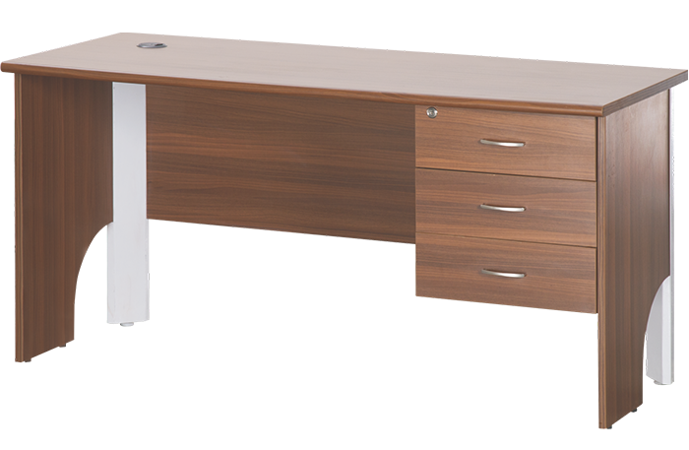
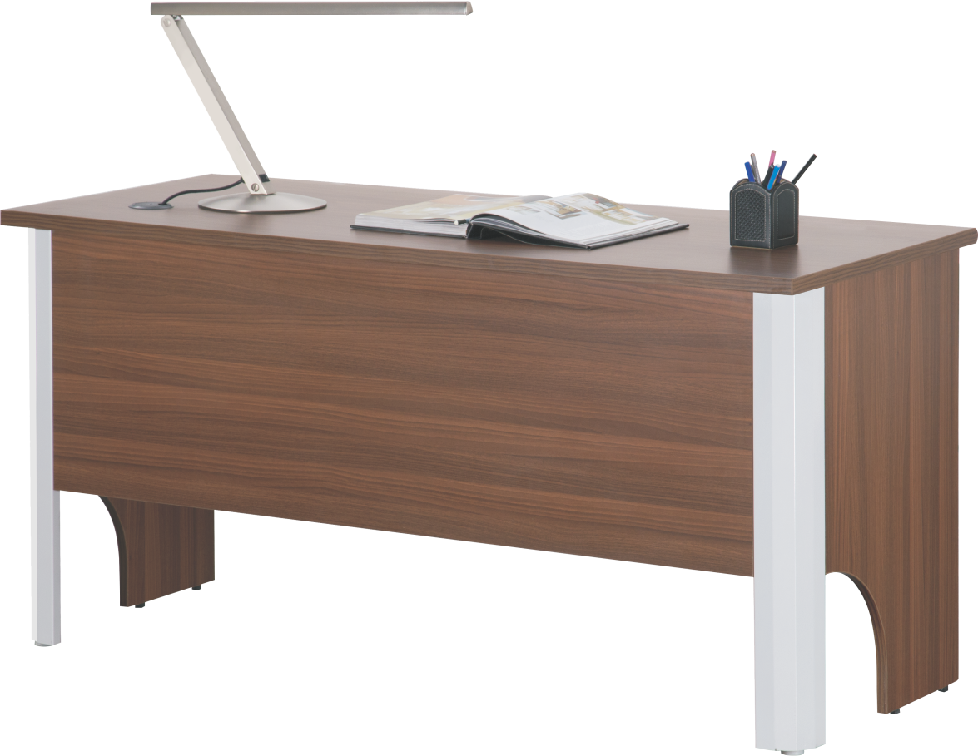
EXCEL SERIES

Slide 10
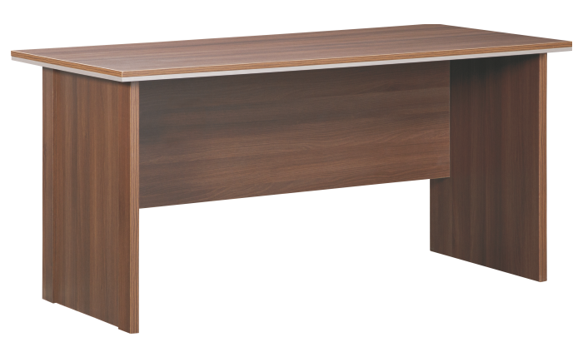
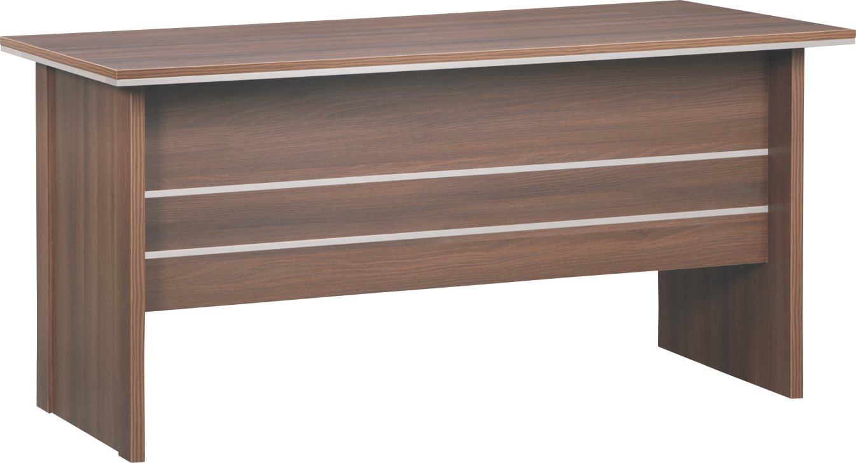
AMAZE SERIES

Slide 11
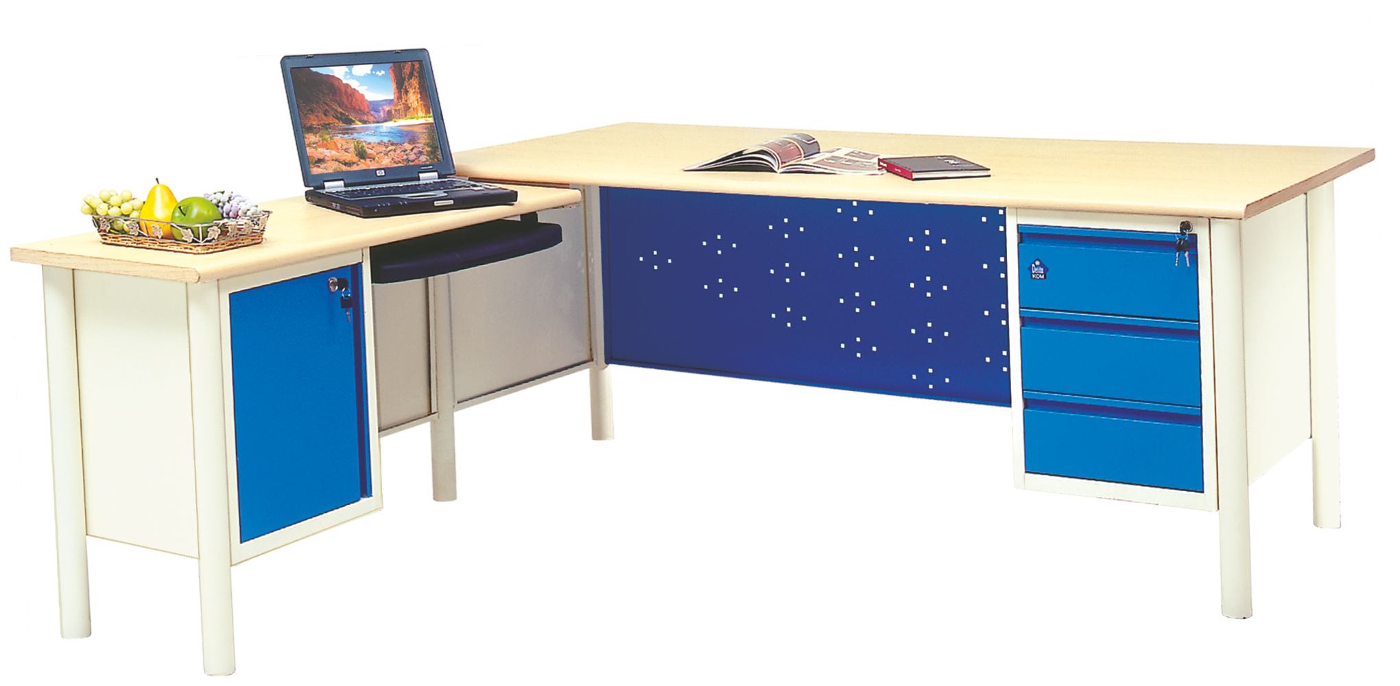
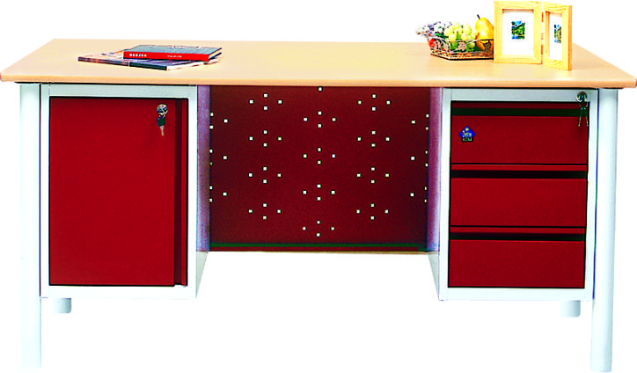
LEGEND SERIES

Slide 12
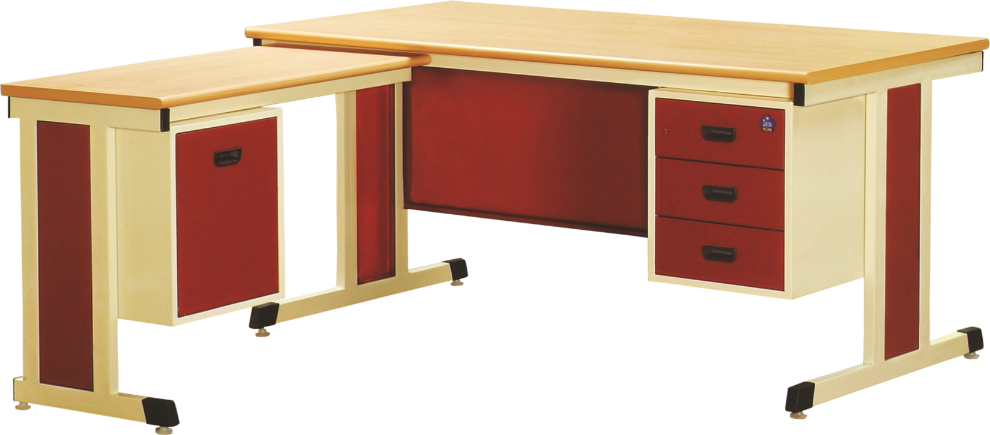
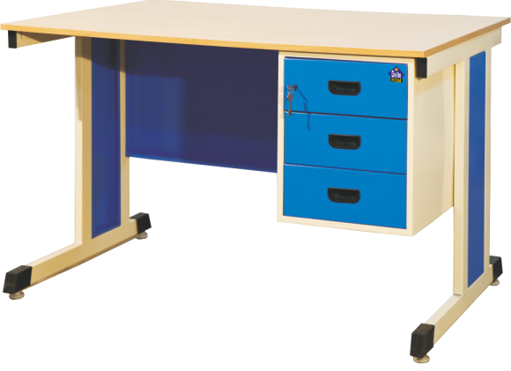
OA TABLE

Slide 13
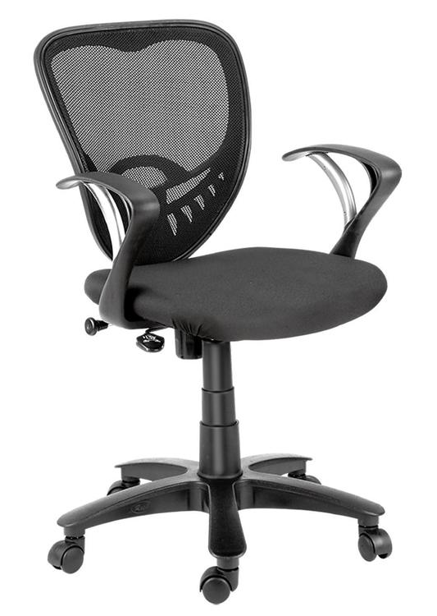
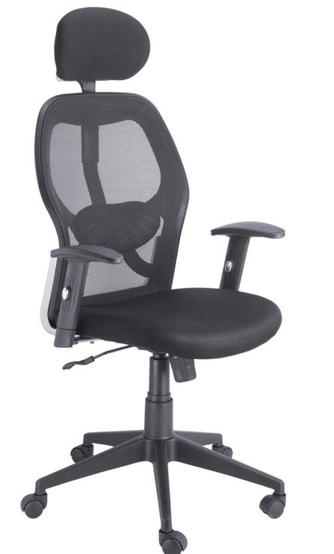
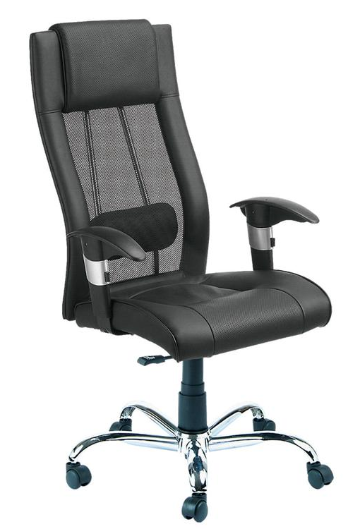
EXECUTIVE MESH BACK CHAIRS
Vista
Flextra
Moss

Slide 14


CONFERENCE TABLES

Slide 15
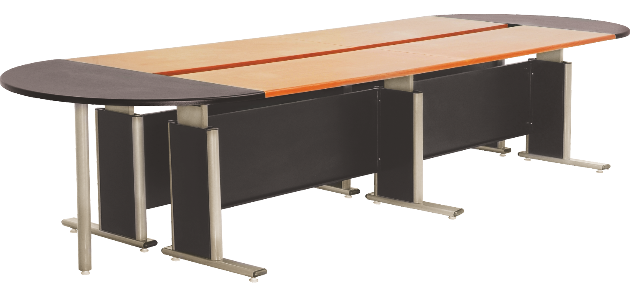
AERO SERIES

Slide 16
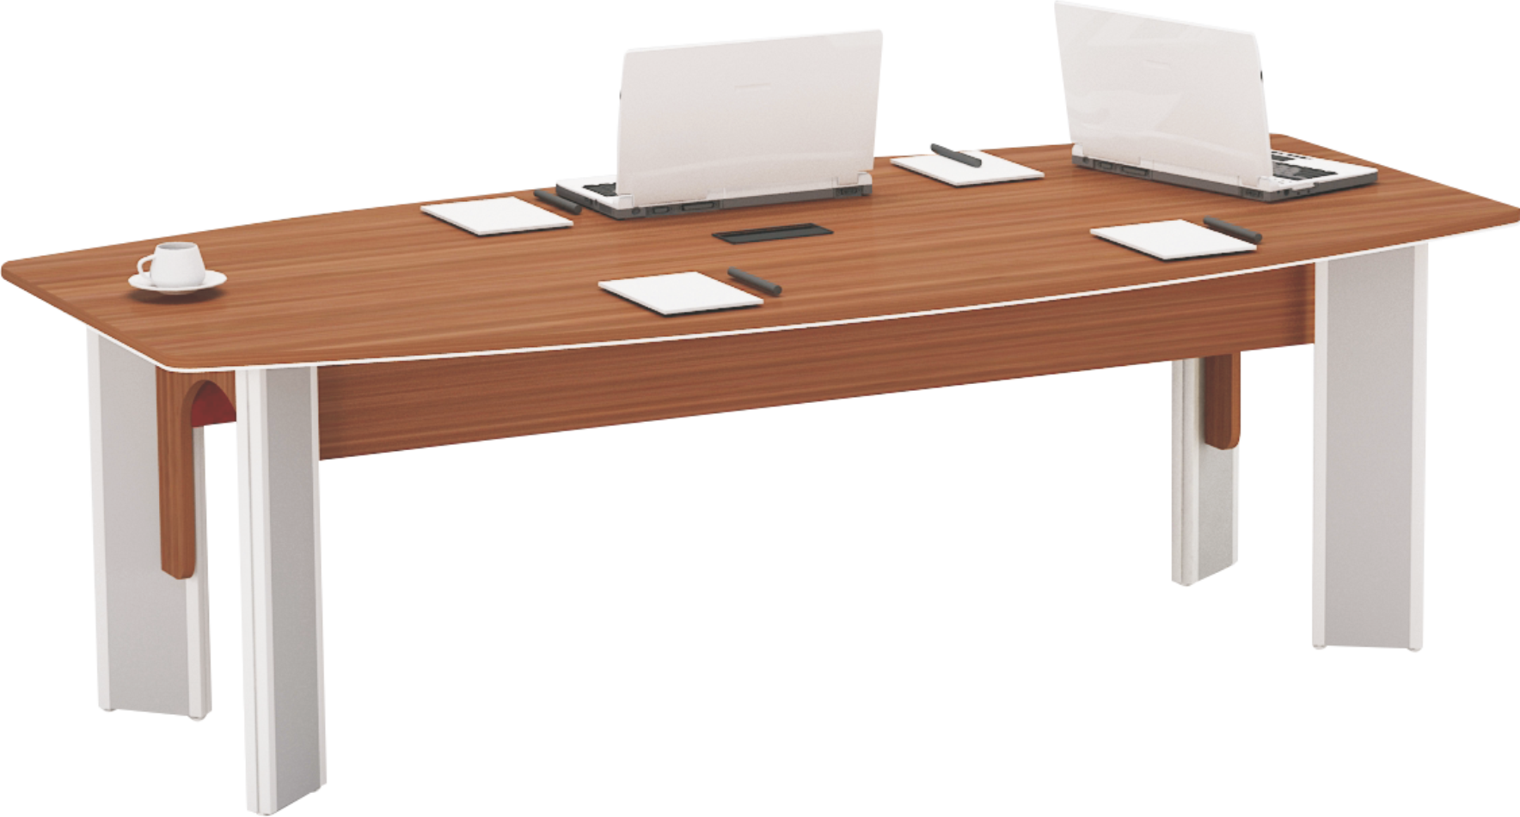
ANGELO
SERIES

Slide 17
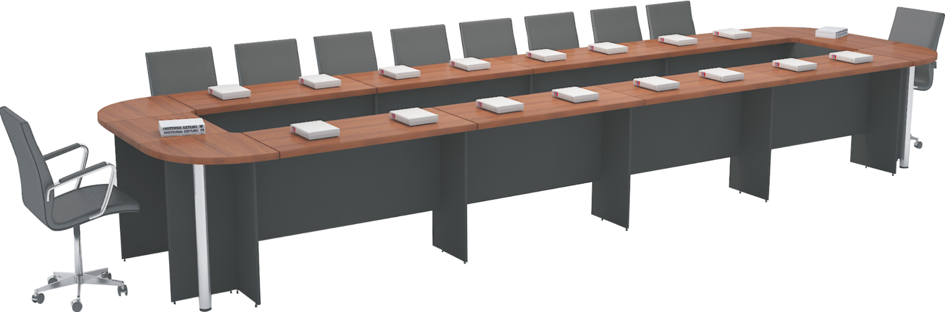
VERSATILE SERIES

Slide 18
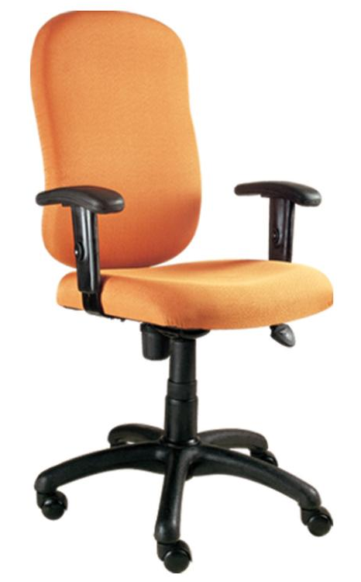
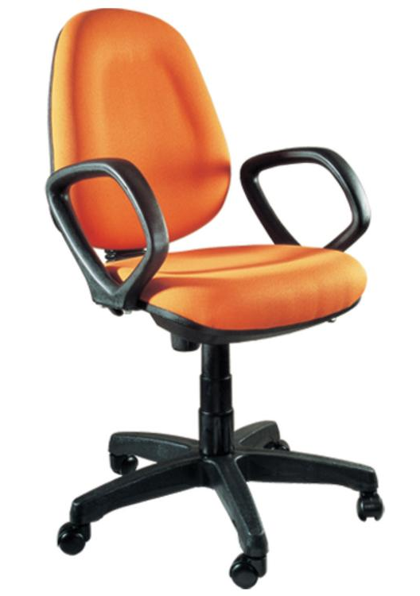
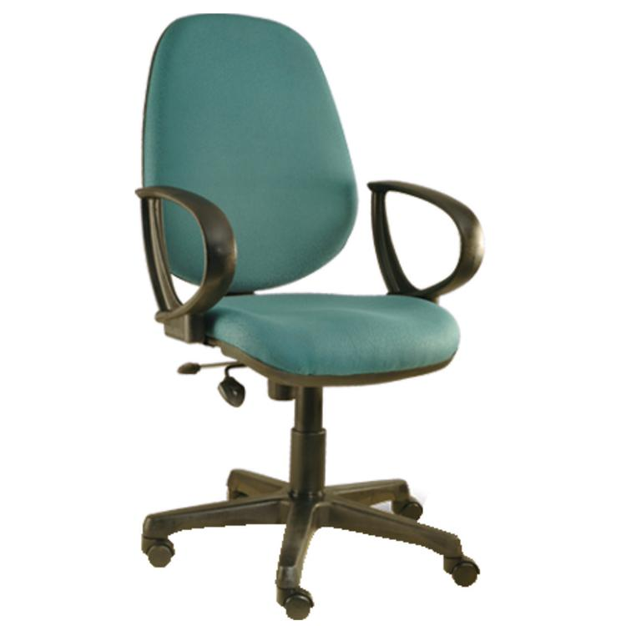
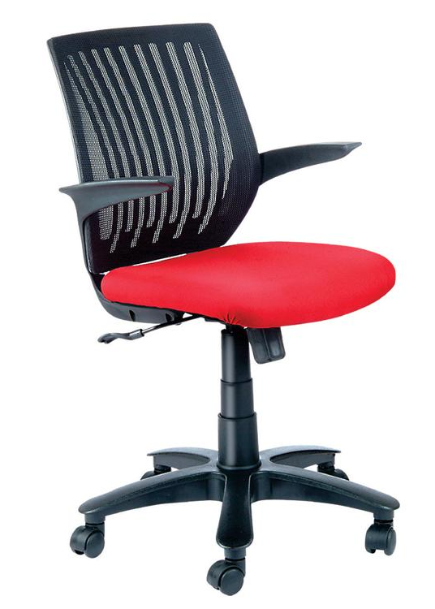
WORKSTATION CHAIRS
FLEXTRA
T SERIES
GLOBAL MANAGER
MILLENIUM

Slide 19
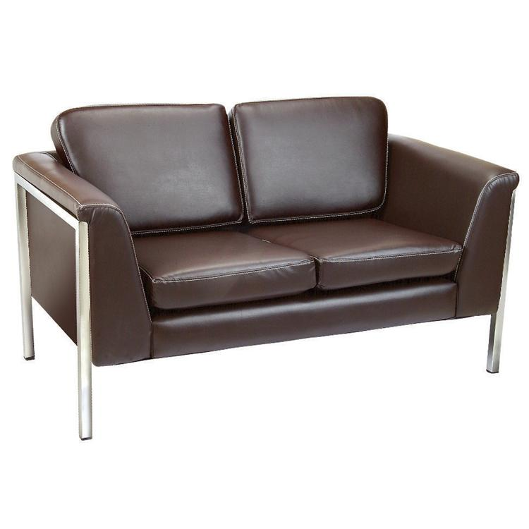
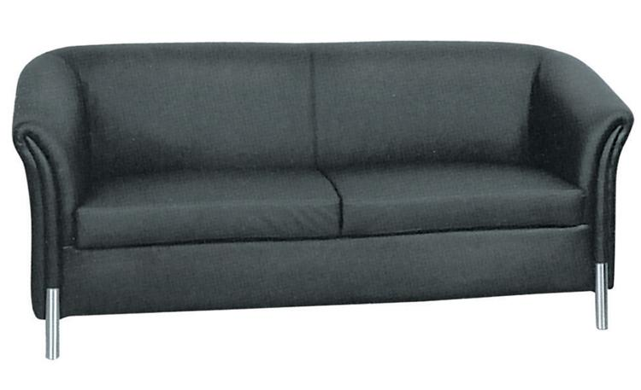
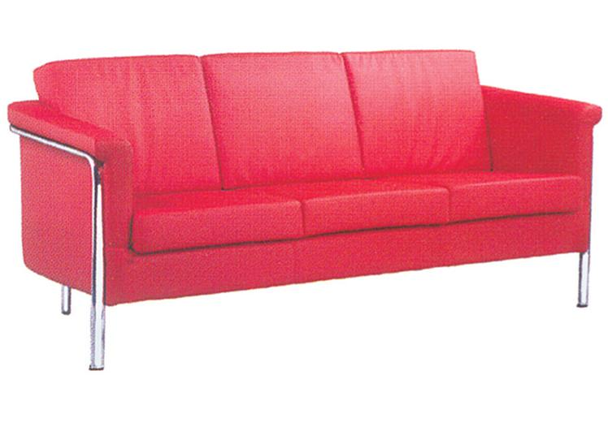
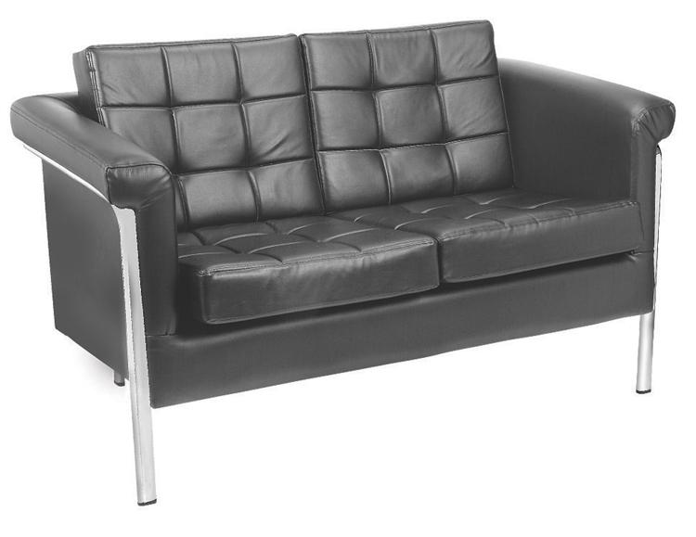
DK 5612
DK 5592
SOFAS
DK 5602
DK 5523

Slide 20
STORAGE
ORGANISING FILES AND DOCUMENTS MADE EASY WITH OUR STORAGE RANGE!
OVER HEAD CABINETS
MULTI PURPOSE CABINETS AND ALMIRAHS
LOCKER CABINETS
FILING CABINETS
COMPACTORS

Slide 21
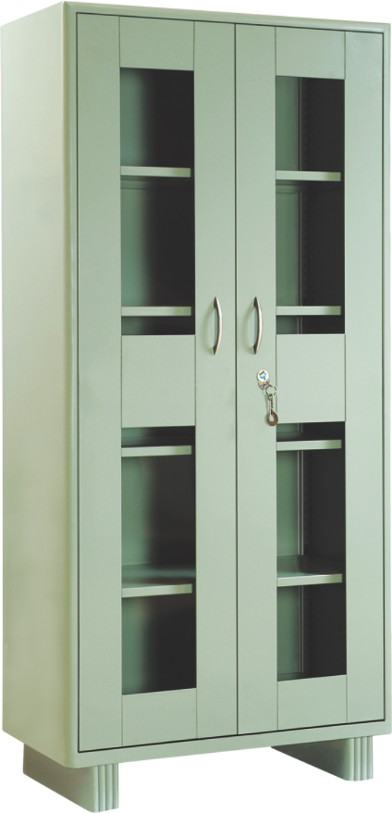
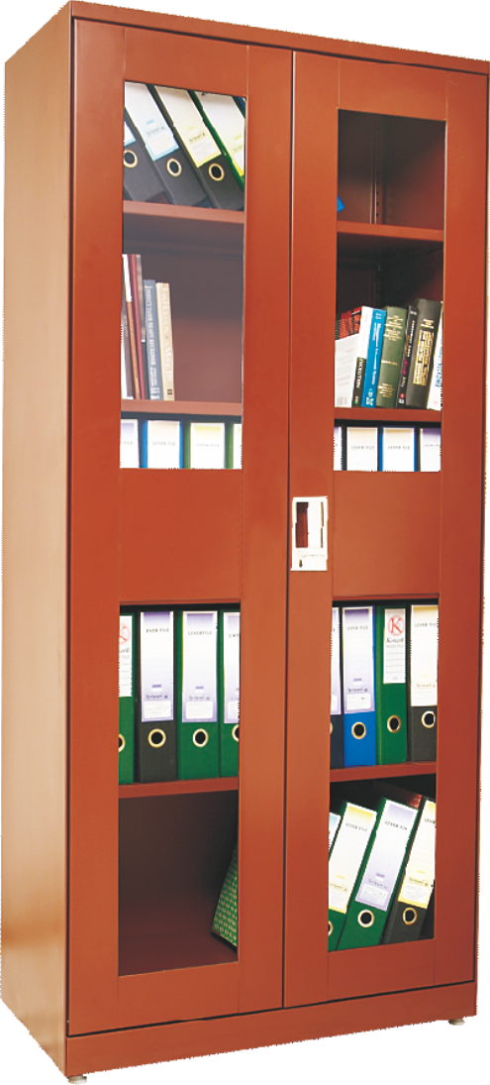
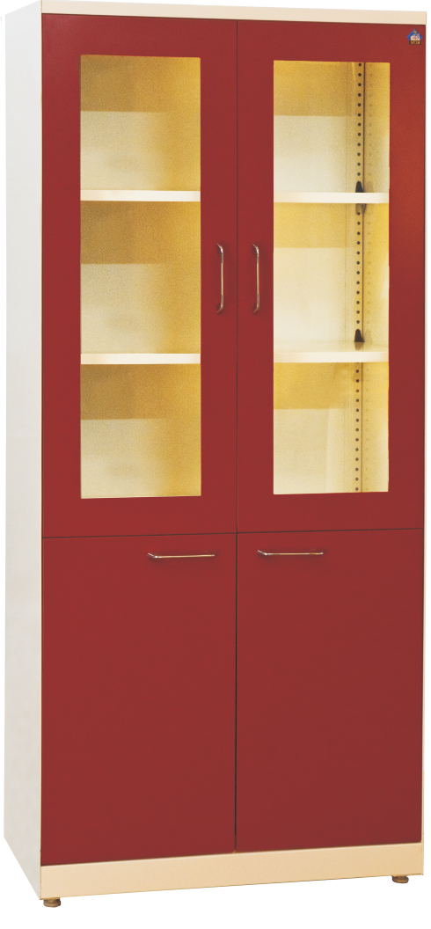
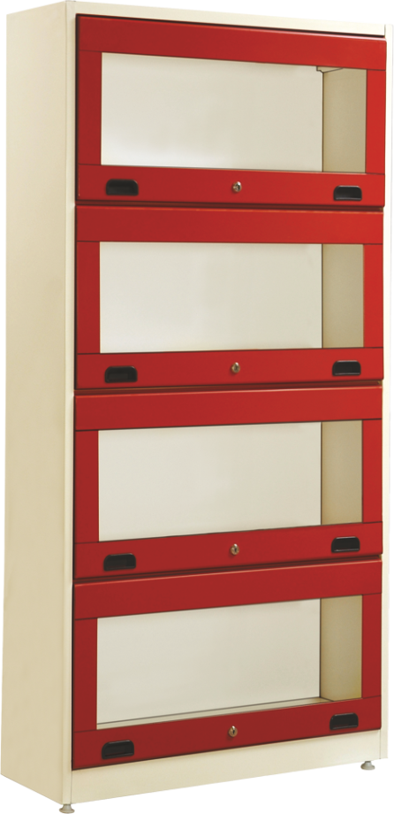
LIBRARY CABINETS

Slide 22
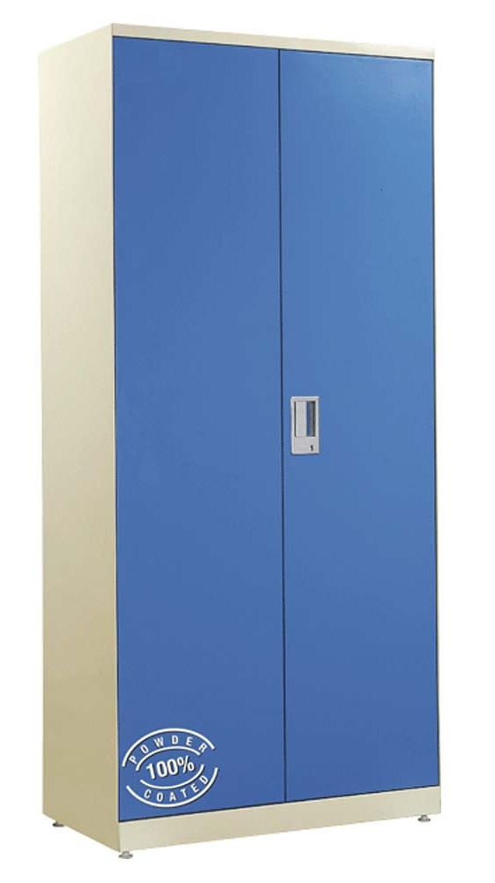
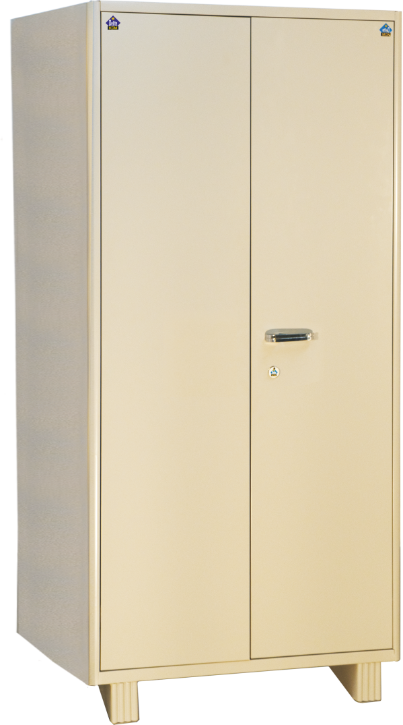
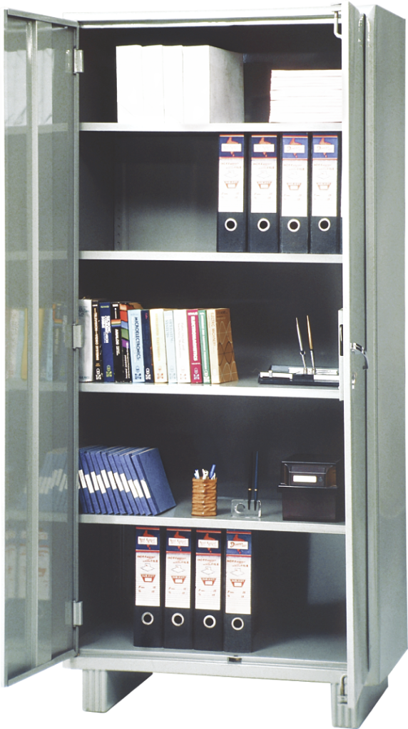
MULTI PURPOSE CABINETS

Slide 23
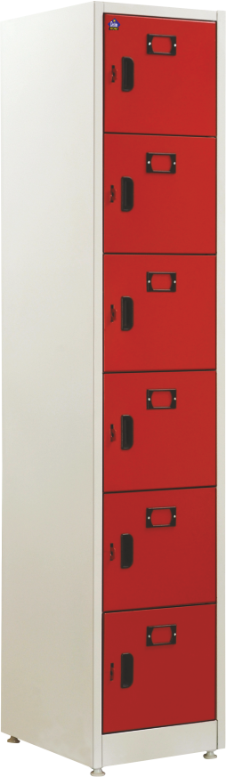
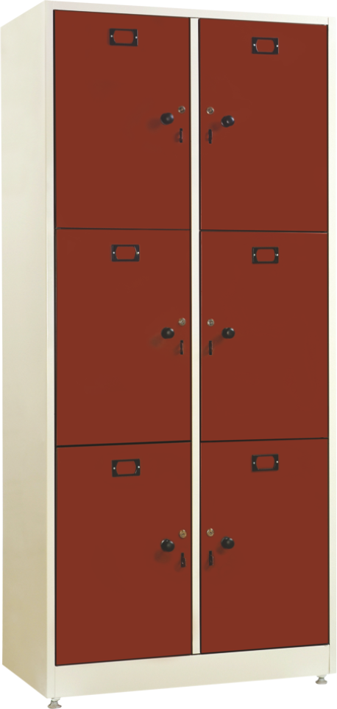
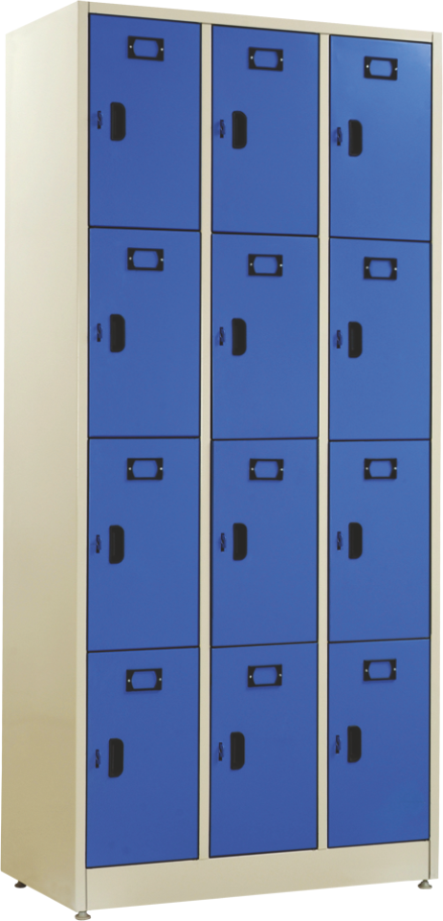
LOCKER CABINETS

Slide 24
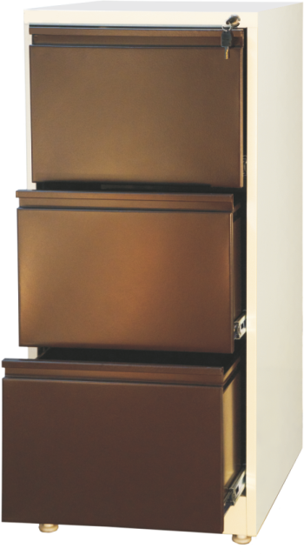
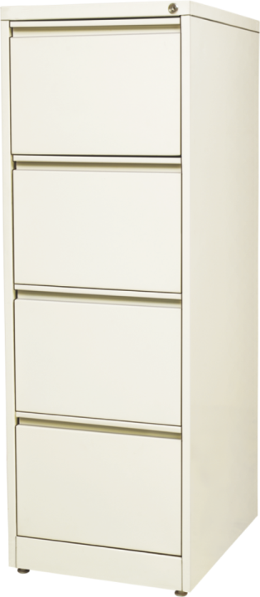
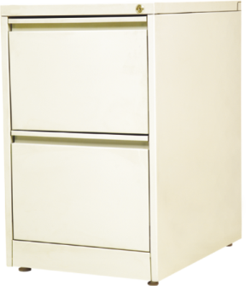
BOSTON FILING CABINETS

Slide 25
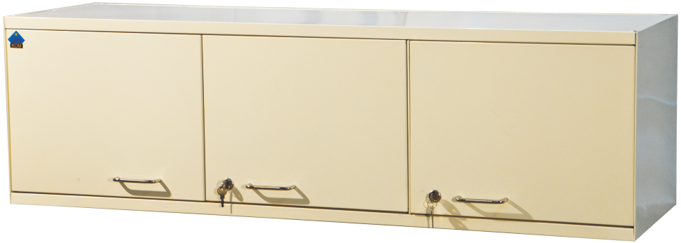
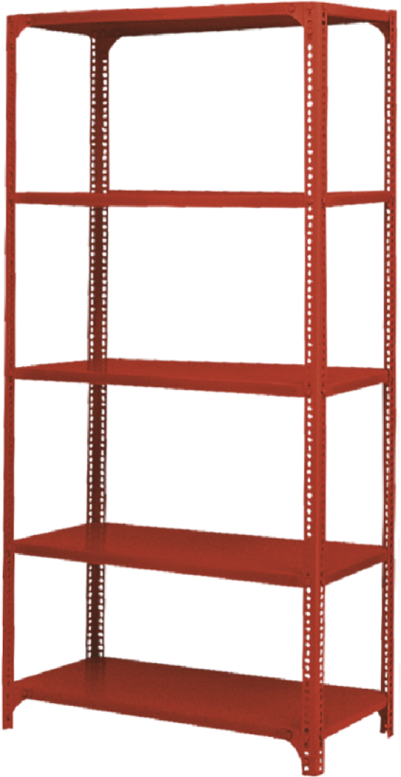
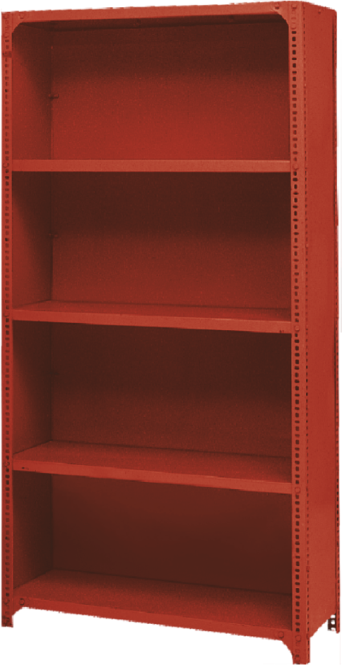
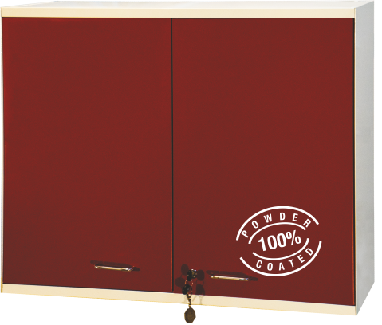
OVER HEAD CABINETS
STORAGE RACKS

Slide 26
COMPACTOR STORAGE SOLUTIONS
Delite Kom Infinity Compact Storage System is a multi-utility product to store documents, files and other items in a secured and easy manner

Slide 27


INFINITY COMPACT MOBILE STORAGE SYSTEM

Slide 28


Slide 29

Delite Kom is an Industry Leader in Steel Furniture in India for the last 60 years

Slide 30




OUR CERTIFICATIONS
ISO 18001
BMS CERT
ISO 9001
ISO 14001

Slide 31














OUR PRESTIGIOUS CLIENTS AND PROJECTS
IIT ROORKEE
IIT KANPUR
IIT DELHI
IIIT PRAYAGRAJ
IIIT JABALPUR
AIIMS
CWC
PWD
CPWD
NCERT
UGC
DELHI UNIVERSITY
GB PANT UNIVERSITY, UTTRAKHAND
BURSAR AGRICULTURE AND TECHNOLOGY UNIVERSITY, UTTRAKHAND
BANARAS HINDU UNIVERSITY
IIT BHU, BANARAS
INDIAN RAILWAYS

Slide 32

THANK YOU
Ph. : +91 9650592244
Head Office : Kukreja House, 2nd Floor, 46 Rani Jhansi Road, New Delhi 110055
Phone No. 011-46287777
delite@delitekom.com

